Slide 1



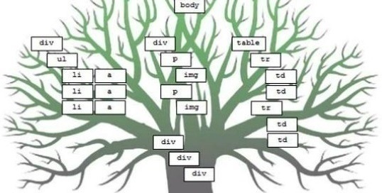
DOM and Events
Document Object Model (DOM) Events Handling in JavaScript
Svetlin Nakov
Technical Trainer
www.nakov.com
Software University
http://softuni.bg

Slide 2


Table of Contents
Document Object Model (DOM)
The DOM API Overview
Selecting DOM Elements
NodeLists (Live & Static)
JavaScript Event Model
Registering Event Handlers
The "event" Object
Capturing and Bubbling Events

Slide 3
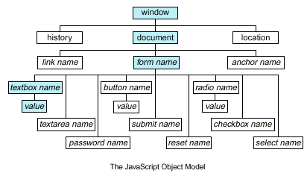
Document Object Model (DOM)

Slide 4
Document Object Model
What is Document Object Model (DOM)?
A concept of representing a HTML document as a "DOM tree"
Consists of elements that have child elements
Elements have properties (attribute + value) and events
DOM provides an API for traversing / modifying the DOM tree
Enables developers to modify the HTML content and the visual presentation of the currently loaded HTML document
E.g. load a table data (JSON) and show it as a HTML table

Slide 5
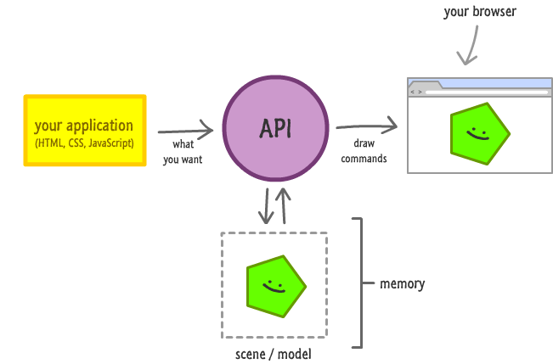
The DOM API

Slide 6
The DOM API
Web browsers provide a DOM API
Consists of objects and methods to interact with the HTML page
Can add / modify / remove HTML elements
Can add / modify / remove HTML attributes
Can apply CSS styles dynamically
HTML elements and their properties are mapped to JS objects
document.documentElement is the <html> element
document.body is the <body> element of the page

Slide 7
HTML Elements – Common Properties
All HTML elements have common properties
Corresponding to the their HTML attributes
id, className, style, onclick, etc.
innerHTML
Holds a string – the content of the element, without the element
outerHTML
Holds a string – the content of the element, with the element
innerText / textContent
Holds a string – the text content of the element, without the tags

Slide 8
DOM Objects and Types
Each HTML element has a corresponding DOM object type
HTMLLIElement represents <li>
HTMLAudioElement represents <audio>
Each of these objects have its specific properties
HTMLAnchorElement has href property
HTMLImageElement has src property
HTMLInputElement has value property
The document object is a special object
It represents the entry point for the DOM API (the DOM tree root)

Slide 9

DOM Objects
Live Demo

Slide 10
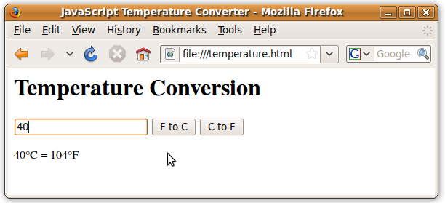
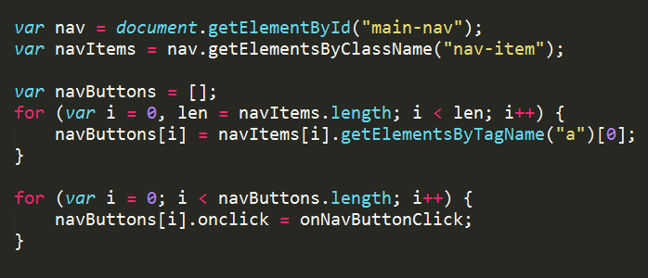
Selecting DOM Elements

Slide 11
Selecting HTML Elements from DOM
Select a single element → returns HTMLElement
Select a collection of elements → returns a collection
Access the predefined collections of elements
var header = document.getElementById('header');
var nav = document.querySelector('#main-nav');
var inputs = document.getElementsByTagName('li');
var radiosGroup = document.getElementsByName('genders[]');
var header = document.querySelectorAll('#main-nav li');
var links = document.links;
var forms = document.forms;

Slide 12
Selecing with document.getElementsBy…
Select element by ID → returns HTMLElement
Select elements by CSS class → returns a collection
Select elements tag name → returns a collection
Select element by name (in forms) → returns a collection
var header = document.getElementById('header');
var posts = document.getElementsByClassName('post-item');
var sidebars = document.getElementsByTagName('sidebar');
var gendersGroup = document.getElementsByName('genders[]');

Slide 13

document.getElementsBy…
Live Demo

Slide 14
Query Selectors
CSS-like selectors for accessing the DOM tree
querySelector(…)
Returns the first element that matches the selector
querySelectorAll(…)
Returns a collection of all elements that match the selector
var header = document.querySelector('#header');
var tableCells = document.querySelectorAll('table tr td');
var selectedLi = document.querySelector('menu > li.selected');
var specialLinks = document.querySelectorAll('a.special');

Slide 15
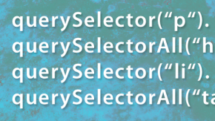
Query Selectors
Live Demo

Slide 16
Selecting Inner Elements
HTML elements support select for their inner elements
Select all DIVs that are inside an element with id "wrapper"
All methods can be used on HTML elements
Except getElementById()
var wrapper = document.getElementById('wrapper');
var divsInWrapper = wrapper.getElementsByTagName('div');

Slide 17

Selecting Inner Elements
Live Demo

Slide 18
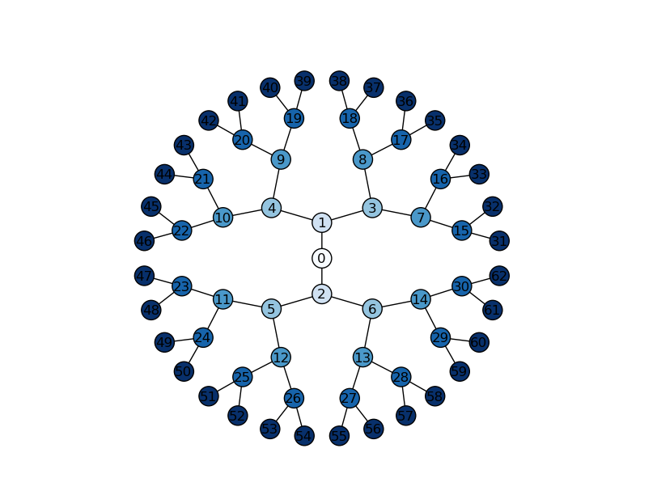
NodeList

Slide 19
NodeList
A NodeList is a collection returned by the DOM selectors:
getElementsByTagName(tagName)
getElementsByName(name)
getElementsByClassName(className)
querySelectorAll(selector)
https://developer.mozilla.org/en/docs/Web/API/NodeList
var divs = document.getElementsByTagName('div');
var queryDivs = document.querySelectorAll('div');
for (var i=0; i<divs.length; i++) {
// Do something with divs[i] …
}

Slide 20

NodeList
Live Demo

Slide 21

Static NodeList & Live NodeList

Slide 22
Static and Live NodeList
There are two kinds of NodeList collections
getElementsBy…() returns a live NodeList
querySelectorAll() returns a static NodeList
Live lists keep track of the selected elements
Even when changes are made to the DOM
While static list contain the elements as they were at the execution of the method
Keep in mind that live NodeList is slower than a regular array
Need to cache its length for better performance

Slide 23

Static NodeList and Live NodeList
Live Demo

Slide 24
Traversing the DOM
body
header
div#wrapper
footer
h1#logo
nav #main-nav
h2
nav
Create, Remove, Alter and Append HTML Elements

Slide 25
Traversing the DOM
DOM elements know their position in the DOM tree
Parent: element.parentNode
Returns the direct parent of the element (null for the document)
Children: element.childNodes
Returns a NodeList of all the child nodes (including the text nodes)
First / last child – element.firstChild / element.lastChild
Siblings (elements around the element):
element.nextSibling / element.nextElementSibling
element.previousSibling / element.previousElementSibling

Slide 26
Traversing the DOM – Example
var trainersList =
document.getElementsByClassName("trainers-list")[0];
var parent = trainersList.parentNode;
log("parent of trainers-list: " + parent.nodeName +
" with id: " + parent.id);
var children = trainersList.childNodes;
log("elements in trainers-list: " + children.length);
log("element in trainers-list");
for (var i = 0, len = children.length; i < len; i++) {
var subItem = children[i]
log(subItem.nodeName + " content: " + subItem.innerText);
}

Slide 27
Manipulating the DOM
DOM can be manipulated dynamically with JS
HTML elements can be created
HTML elements can be removed
HTML elements can be altered
Change their content
Change their styles
Change their attributes

Slide 28
Creating HTML Elements
The document object can create new HTML elements
document.createElement(elementName)
Newly created elements are not in the DOM (the web page)
Must be appended to DOM manually
var studentsList = document.createElement("ul");
studentsList.innerHTML = "Student: Pesho";
var liElement = document.createElement("li"); studentsList.appendChild(studentLi);
document.body.appendChild(studentsList);

Slide 29
Inserting Elements Before / After Element
The DOM API supports inserting a element before or after a specific element
element.appendChild(child)
Inserts the element always at the end of the DOM element
parent.insertBefore(newNode, specificElement)
Inserts the element before specific element
parent.insertAfter(newNode, specificElement)
Inserts the element after specific element

Slide 30
Removing Elements
Elements can be removed from the DOM
Using element.removeChild(elToRemove)
Pass the element-to-remove to their parent
var trainers = document.getElementsByTagName("ul")[0];
var trainer = trainers.firstChild;
trainers.removeChild(trainer);
// Remove a selected element
var selectedElement = //select the element
selectedElement.parentNode.removeChild(selectedElement);

Slide 31
Altering the Elements
DOM elements can be changed and removed
With the DOM API each DOM element node can be altered
Change its properties or appearance
<div id="f"><p id="the-p">text</p></div>
<div id="s"></div>
…
var second = document.getElementById("s");
var theP = document.getElementById("the-p");
second.appendChild(theP);
…
// The DOM is:
<div id="f"></div>
<div id="s"><p id="the-p">text</p></div>

Slide 32
Appending DOM Elements
The DOM API supports appending DOM elements to a element
parentNode.appendChild(node)
Appends the DOM element node to the DOM element parentNode
If parentNode is appended to the DOM, the childNode is also appended

Slide 33

DOM Optimizations

Slide 34
Optimizing the Appending of Elements
Appending elements to the DOM is a very slow operation
When an elements is appended to the DOM, the DOM is rendered anew
All newly created elements must be appended together
Here comes the DocumentFragment element
It is a minimal DOM element, with no parent
It is used to store ready-to-append elements and append them at once to the DOM

Slide 35
Using DocumentFragment
Using DocumentFragment
Append the elements to a DocumentFragment
Appending DocumentFragment to the DOM appends only its child elements
http://ejohn.org/blog/dom-documentfragments/
var div = document.createElement('div');
var dFrag = document.createDocumentFragment();
dFrag.appendChild(div);
document.body.appendChild(dFrag);

Slide 36

JavaScript Event Model

Slide 37
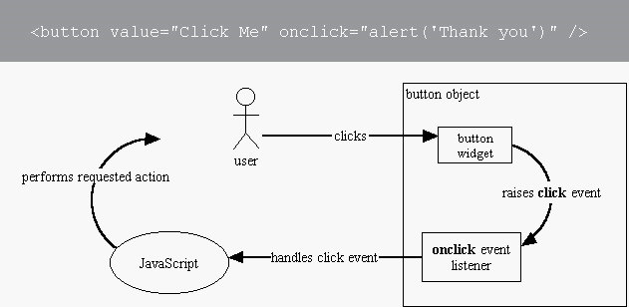
Event Model
The DOM event model provides notifications for certain events
E.g. execute a JS function when a button is clicked
The DOM event model consists of events and event listeners attached to the DOM objects
Events Demo

Slide 38
Event Types
DOM provides access to many events
Mouse events – mouse clicks, mouse moves, mouse over, …
Touch events – finger touch, touch start, end, move, …
Form events – field focus, value change, form submit, …
Keyboard events – key down, key up, key press, …
DOM / UI events – node insert, node remove, load, resize, …
Full list of all DOM event types:
http://www.w3.org/TR/DOM-Level-3-Events/#event-types-list
You may also define custom event types

Slide 39
Common Event Types
Mouse events
DOM / UI events
click
hover
mouseup
mousedown
mouseover
mouseout
load
abort
select
resize
change
Touch events
touchstart
touchend
touchcancel
touchleave
touchmove
Keyboard events
Focus events
keydown
keypress
keyup
focus
blur
focusin
focusout

Slide 40
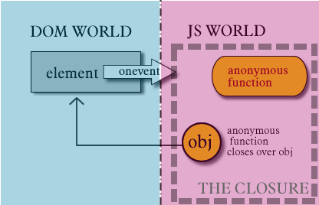
Event Handler Registration

Slide 41
Define Event Handler in the HTML Code
Event handling JavaScript code can be specified in the HTML attributes onclick, onload, onmouseover, onresize, …
<button onclick="buttonClickFunction()">Click Me!</button>
function buttonClickFunction() {
console.log("You clicked the [Click Me!] button");
}
<button onclick="alert('OK clicked')">OK</button>

Slide 42
Define Event Handler in the JS Code
Event handling JavaScript code can be specified in the JS code through the properties onclick, onresize, …
<button id="click-button">Click Me!</button>
<button id="click-button">Click me</button>
var button = document.getElementById("click-button");
button.onclick = function onButtonClick() {
console.log("You clicked the button");
}

Slide 43
Using addEventListener(…)
A more powerful way for attaching event handlers:
isCaptureEvent: catch the "capture" or "bubbling" phase
Can attach multiple events in a chain
domElement.addEventListener(
eventType, eventHandler, isCaptureEvent)
var button = document.getElementById("buttonOK");
button.addEventListener("click", function() {
console.log("You clicked me");
}, false);

Slide 44
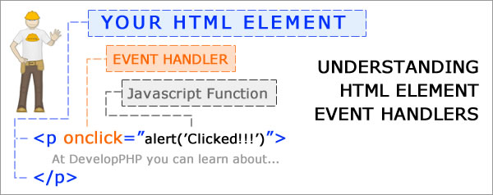
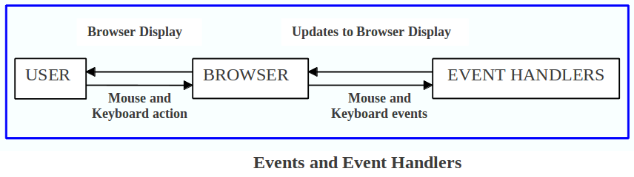
Event Handlers
Live Demo

Slide 45
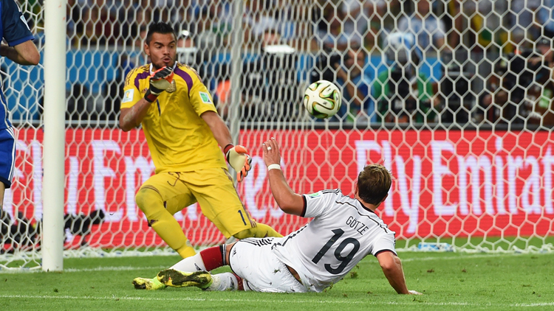
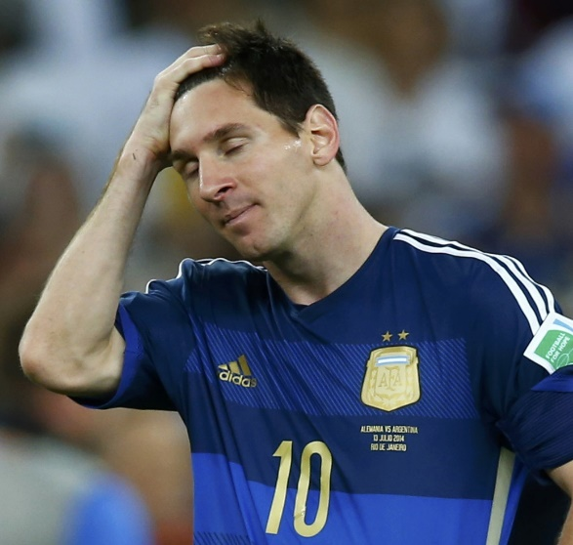
The "event" Object
Just take it

Slide 46
The "event" Object
The "event" object holds information about the event
Passed as parameter to the event handling function
The event object contains information about:
The type of the event (e.g. 'click', 'resize', …)
The target of the event (e.g. the button clicked)
The key pressed for keyboard events
The mouse button / cursor position for mouse events
btn.onclick = function(event) { alert(event); }

Slide 47
Event Object
The "event" object is the only argument of the event handler
Old IE versions pass the event in window.event
function onButtonClick(event) {
console.log(event.target);
console.log(event.type);
console.log("(" + event.clientX + ", " + event.clientY + ")"); }
button.addEventListener("click", onButtonClick, false);
function onButtonClick(event) {
if (!event) event = window.event;
// Your event handling code …
}

Slide 48

The "event" Object
Live Demo

Slide 49


Capturing and Bubbling Events

Slide 50
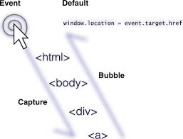
Browser Events Chain
When the user clicks on an HTML element
E.g. on a button in the page
The event is also fired on all of its parents
The button is still the target
But the click event is fired on all of its parents
The click event is fired on all elements in the chain

Slide 51
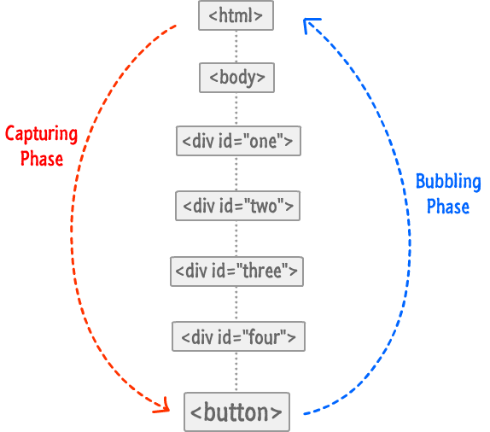
Event Chains: Types
Capturing handlers go down the chain
The first executed handler is on the parent
The last executed handler is on the target
Bubbling handlers bubble up to the parent
The first executed handler is on the target
Then its parent's, and its parent's, etc.
Capturing and Bubbling Explained
domElement.addEventListener(eventType,
eventHandler, isCaptureEvent)

Slide 52

Event Chain
Live Demo

Slide 53


Summary
Document Object Model (DOM)
The DOM API
Selecting DOM elements
NodeLists (live & static)
Creating / modifying / deleting elements
JavaScript Event Model
Event handler registration
The "event" Object
Capturing and bubbling events
JS Basics

Slide 54







JavaScript DOM and Events
https://softuni.bg/courses/javascript-basics

Slide 55
License
This course (slides, examples, demos, videos, homework, etc.) is licensed under the "Creative Commons Attribution-NonCommercial-ShareAlike 4.0 International" license
Attribution: this work may contain portions from
“JavaScript Basics" course by Telerik Academy under CC-BY-NC-SA license

Slide 56




Free Trainings @ Software University
Software University Foundation – softuni.org
Software University – High-Quality Education, Profession and Job for Software Developers
softuni.bg
Software University @ Facebook
facebook.com/SoftwareUniversity
Software University @ YouTube
youtube.com/SoftwareUniversity
Software University Forums – forum.softuni.bg

